Slide 1
Presentation 2 Peer -Programming
COIT11241
JAMIE SHIELD TERM 2 2023
CHELSEA AJISAKA
FRANCIS RENZAHO
MATHEW GALLEHAWK

Slide 2
Topic 2 Implement safeguard CIS 2.5 Allowlist Authorized Software
Background
Our client is the Business Owner of the “Monto Caravan and Cabin Park”.
The Business Owner has requested we improve the cybersecurity of her workstation.
We must develop a portfolio of evidence of the implementation and testing of a safeguard.
The end user utilizes a windows 11 workstation.
The task is to implement a solution to increase the security of her workstation.
Our Solution
Create a PowerShell script that implements an app allowlist using WDAC
Create 1 script called defend.ps1 with 4 functions:
testWDAC() – opens an untrusted app, and logs success or failure.
setupWDAC() – compiles a block policy.
enableWDAC() –applies block policy.
resetWDAC() – removed the block policy.

Slide 3
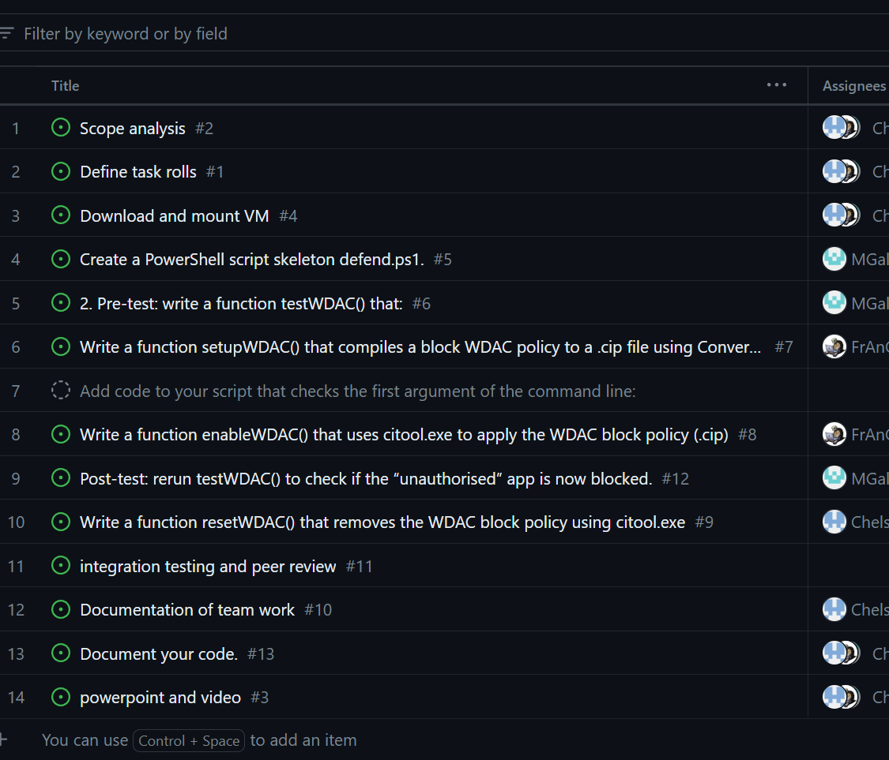
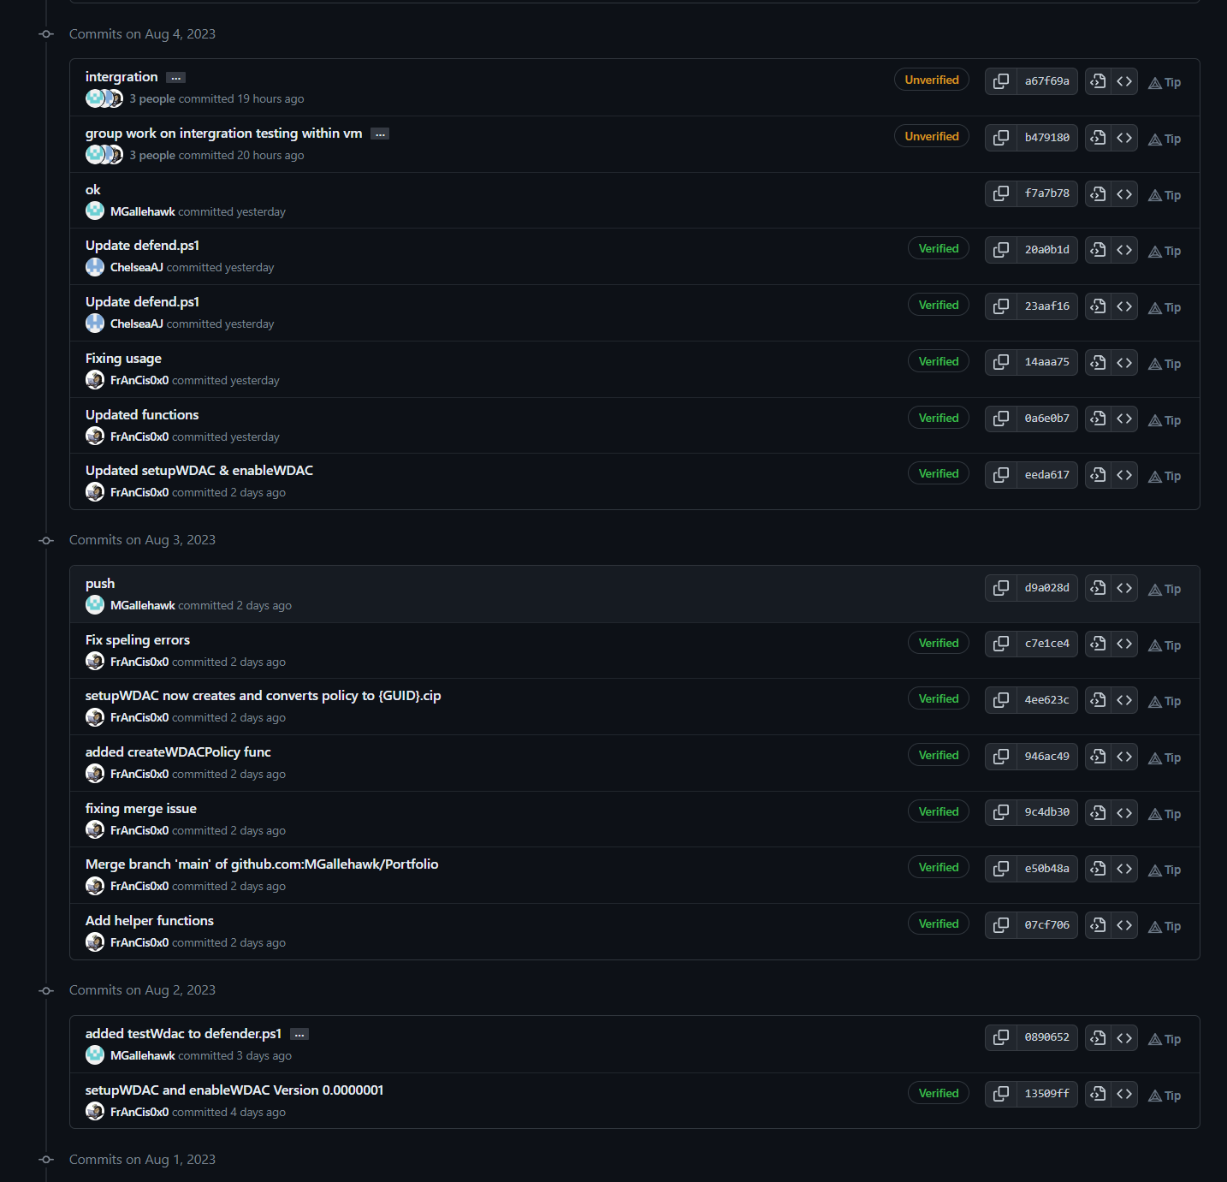
Communication & Team Management
Git-Hub
We utilized Git-Hub to work on the same project at different times.
Comments and notes in the commits help to understand and review change.
Able to keep everyone working on the same project.
Projects
We utilised projects within Git Hub to manage what need to be done and who is responsible.
Teams
Microsoft Teams was our talk about channel, as well as our meeting platform.
Team Viewer
Team viewer granted us the ability to share access to a VM for integration testing.

